Slide 1

Hyatt Regency walkway collapse

Slide 2
BACKGROUND
On July 17, 1981, two walkways collapsed at the Hyatt Regency Kansas City hotel in Kansas City, Missouri, one directly above the other. They crashed onto a tea dance being held in the hotel's lobby, killing 114 and injuring 216. It was the deadliest structural collapse in American history until the collapse of the World Trade Center towers 20 years later.
Construction began in May 1978 on the 40-story Hyatt Regency Kansas City, and the hotel officially opened on July 1, 1980.
The hotel's lobby was one of its defining features, which incorporated a multi-story atrium spanned by elevated walkways suspended from the ceiling. These steel, glass, and concrete crossings connected the second, third, and fourth floors between the north and south wings. The walkways were approximately 120 ft (37 m) long and weighed approximately 64,000 lb (29,000 kg). The fourth-level walkway was directly above the second-level walkway.

Slide 3
COLLAPSE
Approximately 1,600 people gathered in the atrium for a tea dance on the evening of Friday, July 17, 1981.
The second-level walkway held approximately 40 people at around 7:05 p.m., with more on the third and fourth floor walkways.
The fourth-floor bridge was suspended directly over the second-floor bridge, with the third-floor walkway offset several yards from the others.
Guests heard popping noises moments before the fourth-floor walkway dropped several inches, paused, then fell completely onto the second-floor walkway.
Then both walkways fell to the lobby floor.[

Slide 4
INVESTIGATION
The two walkways were suspended from a set of 1.25-inch-diameter (32 mm) steel tie rods, with the second-floor walkway hanging directly under the fourth-floor walkway.
The fourth-floor walkway platform was supported on three cross-beams suspended by steel rods retained by nuts.
The cross-beams were box girders made from C-channel strips welded together lengthwise, with a hollow space between them.
The original design by Jack D. Gillum and Associates specified three pairs of rods running from the second-floor walkway to the ceiling, passing through the beams of the fourth-floor walkway, with a bolt at the middle of each tie rod tightened up to the bottom of the fourth-floor walkway, and a bolt at the bottom of each tie rod tightened up to the bottom of the second-floor walkway.
Even this original design supported only 60% of the minimum load required by Kansas City building codes.

Slide 5
INVESTIGATION
Havens Steel Company manufactured the rods, and they objected that the whole rod below the fourth floor would have to be threaded in order to screw on the nuts to hold the fourth-floor walkway in place.
These threads would be subject to damage as the fourth-floor structure was hoisted into place. Havens, therefore, proposed that two separate and offset sets of rods be used: the first set suspending the fourth-floor walkway from the ceiling, and the second set suspending the second-floor walkway from the fourth-floor walkway.
In the original design, the beams of the fourth-floor walkway had to support only the weight of the fourth-floor walkway, with the weight of the second-floor walkway supported completely by the rods.
In the revised design, however, the fourth-floor beams supported both the fourth and second-floor walkways,
The fourth-floor beams were only strong enough for 30% of that load.

Slide 6
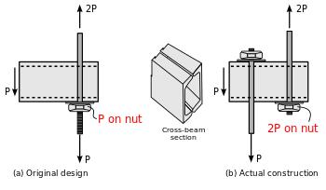
INVESTIGATION
The serious flaws of the revised design were compounded by the fact that both designs placed the bolts directly through a welded joint connecting two C-channels, the weakest structural point in the box beams.
The original design was for the welds to be on the sides of the box beams, rather than on the top and bottom. During the failure, the box beams split along the weld and the nut supporting them slipped through the resulting gap, which was consistent with reports that the upper walkway at first fell several inches, after which the nut was held only by the upper side of the box beams; then the upper side of the box beams failed as well, allowing the entire walkway to fall.
Investigators concluded that the underlying problem was a lack of proper communication between Jack D. Gillum and Associates and Havens Steel.
In particular, the drawings prepared by Gillum and Associates were only preliminary sketches, but Havens interpreted them as finalized drawings.
Gillum and Associates failed to review the initial design thoroughly and accepted Havens' proposed plan without performing necessary calculations or viewing sketches that would have revealed its serious intrinsic flaws — in particular, doubling the load on the fourth-floor beams.

Slide 7
AFTERMATH
A Gillum and Associates project engineer, who accepted Havens' proposed plan over the phone, was stripped of his professional license.
The Missouri Board of Architects, Professional Engineers, and Land Surveyors found the engineers at Jack D. Gillum and Associates who had approved the final drawings to be culpable of gross negligence, misconduct, and unprofessional conduct in the practice of engineering. They were acquitted of all the crimes with which they were initially charged, but the company lost its engineering licenses in the states of Missouri, Kansas, and Texas, as well as its membership with the American Society of Civil Engineers (ASCE).
At least $140 million (equivalent to $334 million in 2018)[was awarded to victims and their families in subsequent civil lawsuits; a large amount of this money was from Crown Center Corporation, a subsidiary of Hallmark Cards which was the owner of the hotel real estate; Hyatt operated the hotel for a fee as a management company and did not own the building.

Slide 8
ETHICAL ISSUES
Those in charge of the construction of the Kansas City Hyatt Regency hotel were charged with professional negligence in regard to the catastrophic walkway collapse
Although those in charge did not authorize the fatal departure from the original design of the walkway support, it was determined that responsible monitoring on their part would have made them aware of the proposed change.
Had it come to their attention, a few simple calculations could have made it evident to them that the resulting structure would be unsafe.

Slide 9
ETHICAL ISSUES
In this case, it was determined that the engineers in charge fell seriously short of accepted engineering practice, resulting in a failure to meet the standard of care.
Satisfying the standard of care cannot guarantee that failure will not occur.
However, failure to satisfy the standard of care itself is not acceptable. In any particular case, there may be several acceptable ways of meeting the standard. Much depends on the kind of project in question, its specific context, and the particular variables that (sometimes unpredictably) come into play.

Slide 10
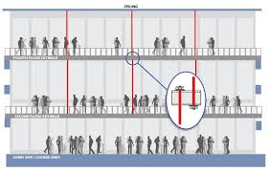
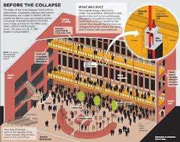

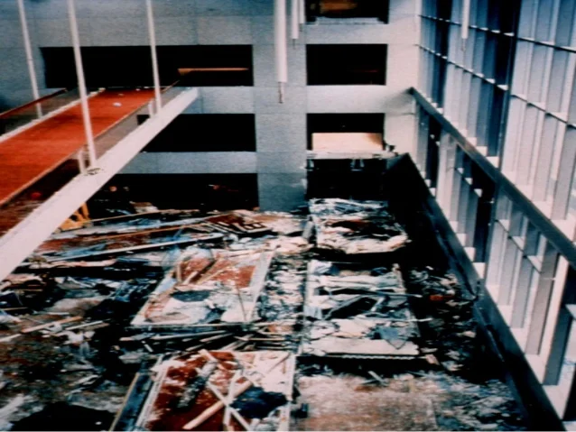
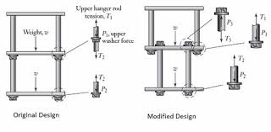

Hyatt Regency walkway collapse

Slide 11
ACKNOWLEDGEMENT
Charles Harris, Michael Pritchard, Michael Rabins : Engineering Ethics – Concepts and Cases; Wadsworth Cengage Learning, 4th Edition
https://en.wikipedia.org/wiki/Hyatt_Regency_walkway_collapse

